Slide 1
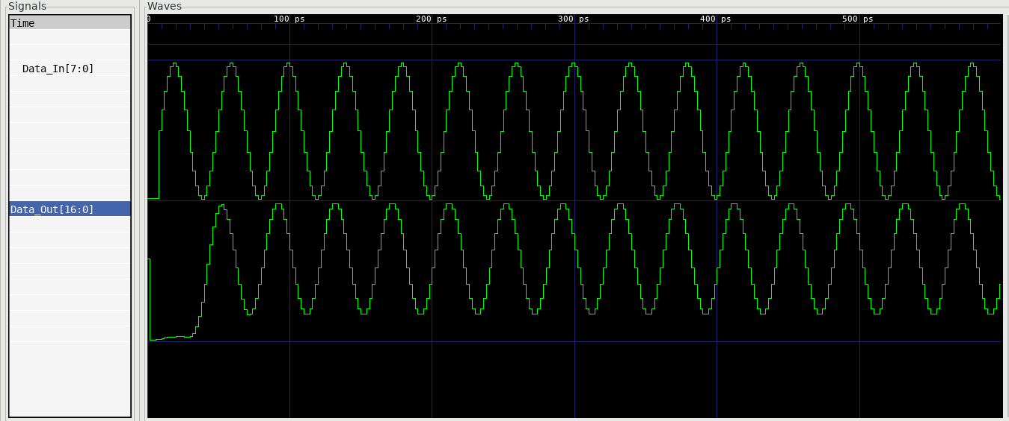
Waveform for sine frequency: 0.05 cycles/sample

Slide 2
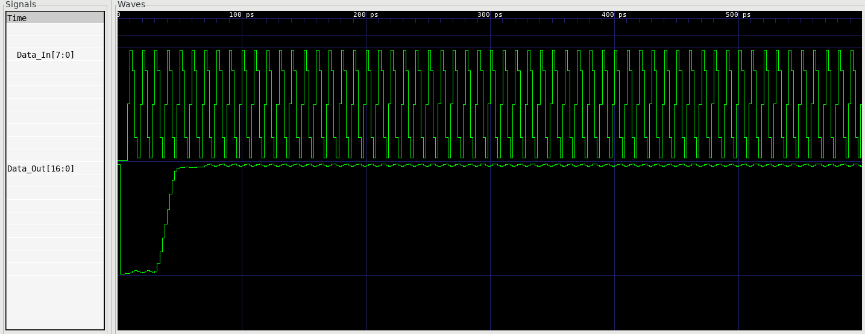
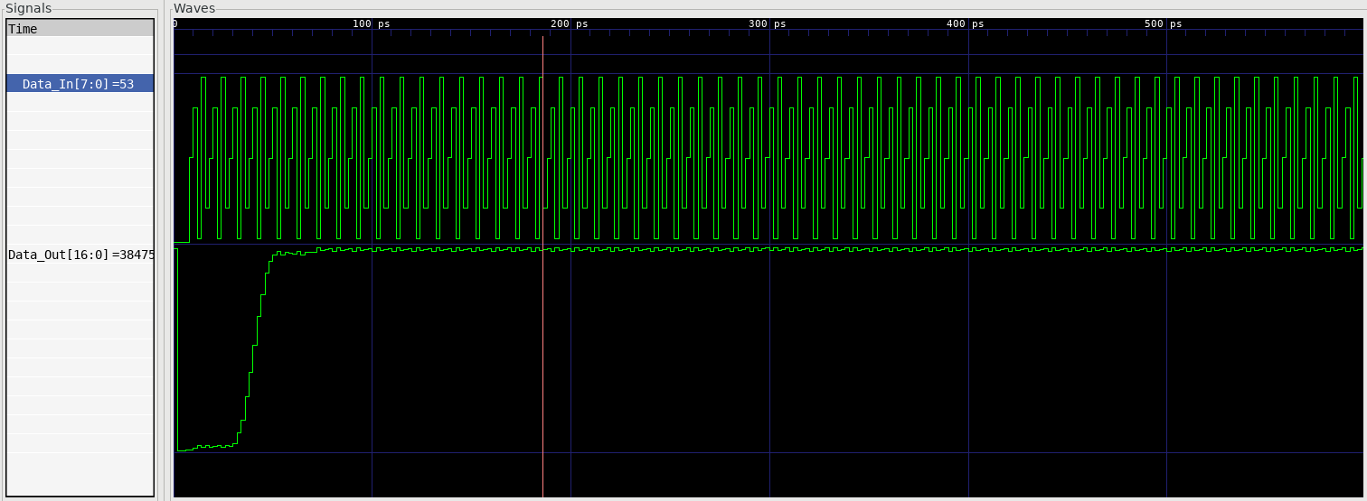
Waveform for sine frequency: 0.20 cycles/sample

